Slide 1

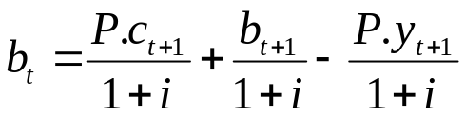

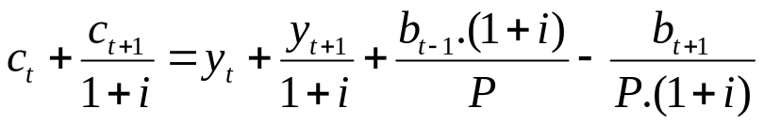
RBC Theory- Intertemporal Substitution II
Robinson could exchange the nuts, he could lend them
We include in the market: 1) Market for Goods
2) Money market
3) Market for Loan Capital
Budget Constraint: where c_{t} and y_{t} are real consumption and output, b is amount of bonds, i nominal interest rate, m nominal amount of money
For two periods: ⇒
(m_{t}=const.)
Issue for Seminar: Find the expression for the budget constraint for more than two periods (3,4,…,n,...∞). How would b.c. change if we allow m and P to grow by constant rate?

Slide 2
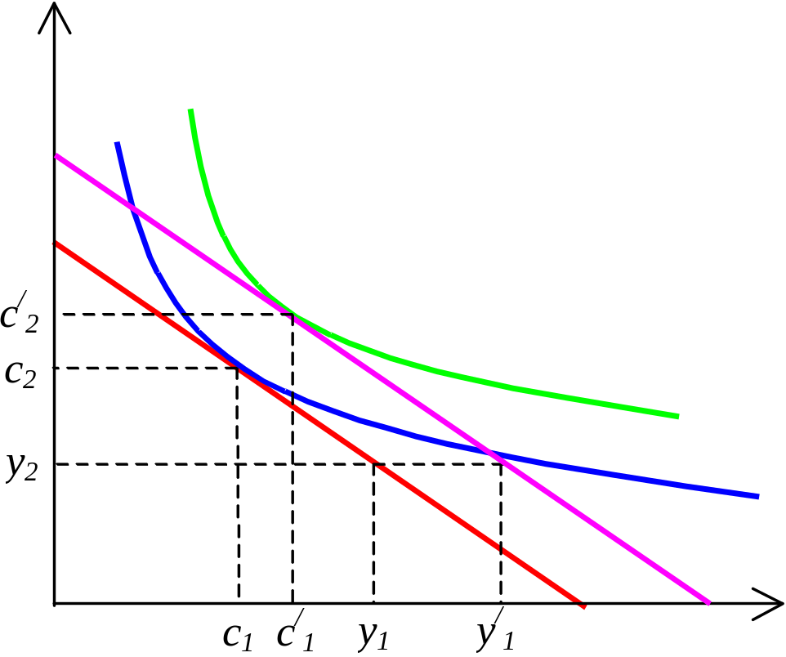
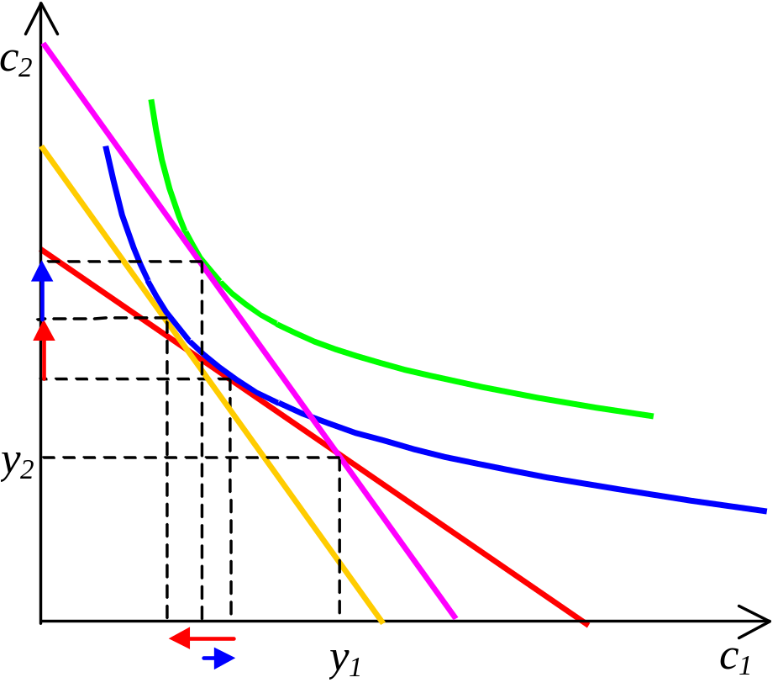
RBC Theory- Intertemporal Substitution II
Increase in W (pure income effect) Increase in i (net creditor)
(income vs. substitution effect)
Issue for seminar: Draw the division between income and substitution effect for increae in interest rate and case of net debtor

Slide 3
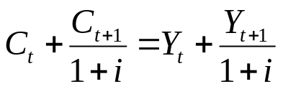
RBC Theory- Intertemporal Substitution II
Increase in i (net creditor)
a) net creditor- ↑i ⇒ ↑W - positive income effect ⇒↑c₁,↑ c₂
- substitution effect ⇒↓c₁,↑ c₂
- total effect ⇒? c₁,↑ c₂
b) net debtor- ↑i ⇒ ↓W - negative income effect ⇒↓c₁,↓ c₂
- substitution effect ⇒↓c₁,↑c₂
- total effect ⇒↓c₁,? c₂
Empirical evidence- influence of interest rates holds for individual households, intertemporal substitution of consumption is not evidential- why?- tha average household is neither debtor, nor creditor, thus Σb_{i}=B_{i}=0.
Interteporal substitution of work (Leisure)- similarly, y₁ and y₂ are functions of l₁ and l₂.
1) Increase in W- pure income effect- ↑c, ↓l in both periods
2) Increase in i- substitution effect- ↑l₁, ↓l₂- today’s free time is relatively more expensive than future- thus increase in saving- ↑i ⇒↑l₁ (⇒↑y₁) & ↓c₁ ⇒↑s₁
Aggregate level- no income effect in case of increase of i.

Slide 4
RBC Theory- Changes in the Production Function
Intertemporal and intratemporal substitution together, Important the duration of an change(temporary vs. permanent change),type of change (parallel vs. proportional shift)
A) Permanent parallel shift to production function- no change to MPL function in both periods; ↑y₁,↑y₂ ⇒↑W ⇒↑c₁,↑c₂, ↓l₁, ↓l₂, increase to real wages in both periods (↑MPL due to ↓l- not shift of the MPL curve, but movement on the curve). ↓l restricts original ↑y but does not outweigh it. mpc→1, mps→0,
B) Temporary parallel shift to production function (in 1st period)- households would push for spilt additional income between current and future consumption. Again no change to MPL function in both periods; ↑W ⇒↑c₁,↑c₂, ↓l₁, ↓l₂, ↑y₁ (↓l₁ does not outweigh primary ↑y₁), ↓y₁ (due to ↓l₁) ; mpc→1/2, mps→1/2,
C) Permanent proportional shift to production function (pure substitution effect)- ↑MPL in both periods⇒ ↑l₁,↑l₂ ⇒↑y₁,↑y₂ (intratemporal substitution); intertemporal effect limited (tha same incrase in MPL in both periods),
D) Temporary proportional shift to production function (pure substitution effect, 1st period)- ↑MPL₁ ⇒ ↑l₁ ⇒↑y₁,↑c₁, but↑y₁ >↑c₁, (intratemporal substitution of consumption); Leisure in 1st period is relatively more expensive- intertemporal substitution of leisure- ↓l₂ ⇒ ↓ y₁, ,↑c₂
Issue for seminar- explore temporary changes to f(y) for changes in second period

Slide 5
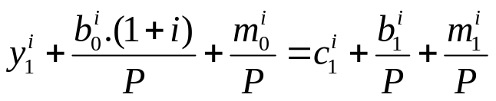
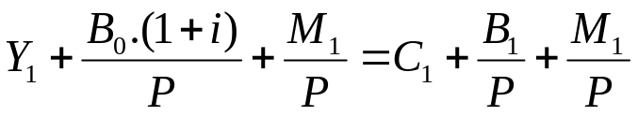


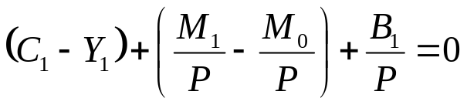
Basic Market Clearing Model
I) Aggregate consistency conditions- i) Income equals consumption (equil. on goods m)
ii) aggregated B=0 (equilibrium on bonds market)
iii) M_{S}=M_{D} (equilibrium on money market)
II) Walras law of markets- if 2 conditions of AC hold, the third must hold as well
for any household i it must hold:
aggregating for all households:
(using and )
And rearranging:
(using assumption B₀=0)
i) C₁=Y₁
ii) B₁=0 if two conditions hold, the third one
iii) M₀=M₁ has to hold as well-we could explore only two markets

Slide 6
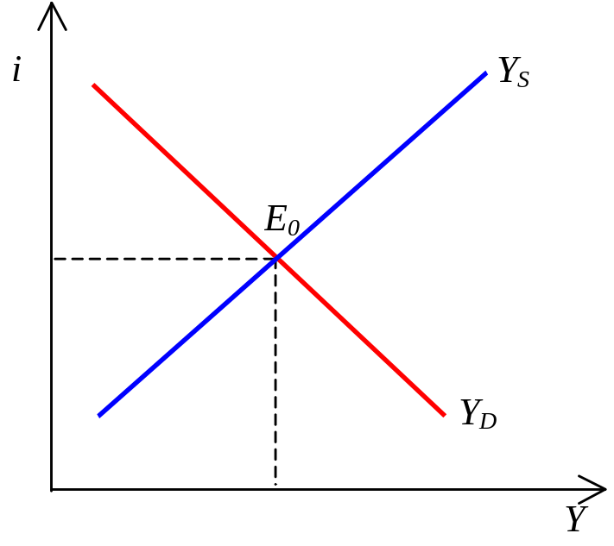
RBC Theory- The Goods Market
The Market clears if C=Y or Y_{D} (R ,...) = Y_{S} (R,...)- clearing variable- interest rate
1) ↑i ⇒ intertemporal substitution thus ↓c and ↑l ⇒ ↑y -move along the curve
2) ↑W (the wealth effect from shift of production function)⇒↑c (thus↑Y_{D} ), ↑l restricts original ↑Y_{S};
3) substitution effect from MPL changes- ↑l ⇒ ↑y, ↑Y_{S}
↑c ⇒ ↑Y_{D} but ↑Y_{S} >↑Y_{D}

Slide 7
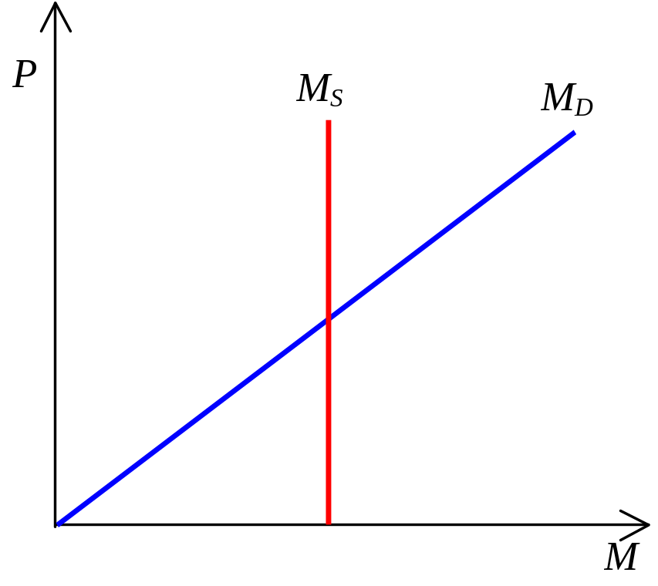
RBC Theory- The Money Market
M_{S} = P . M_{D} / P ( Y , i , tc )
+ - +

Slide 8
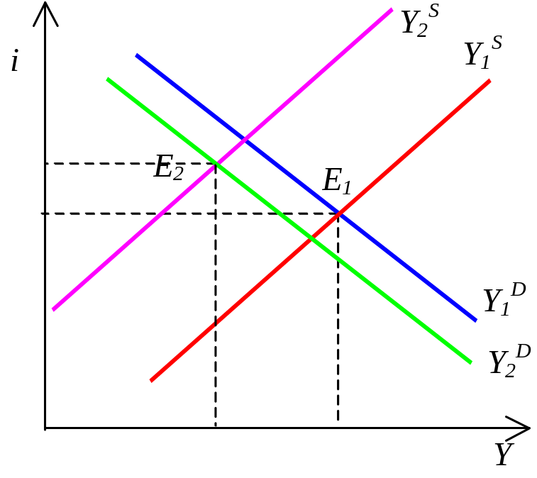
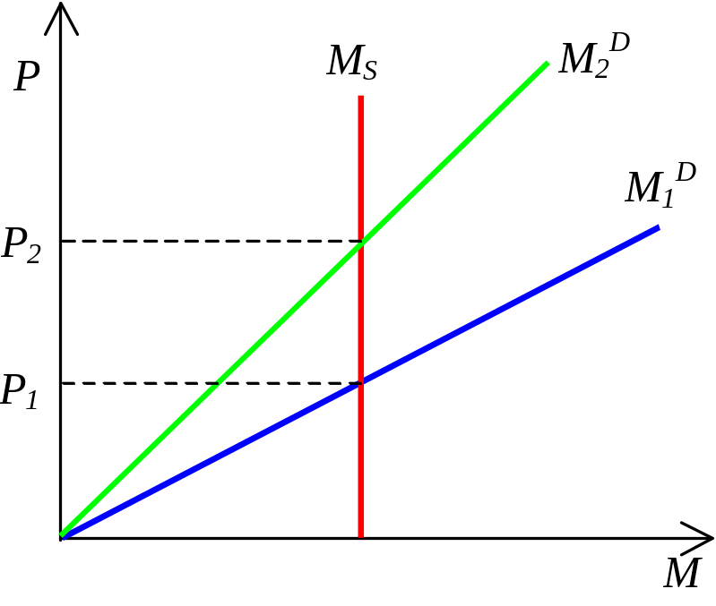
RBC Theory- The Overall Market I
The interest rate and output is given by the goods market (drives M_{D}) the money market is than equalised by P
1) temporary parallel shift to production function down- ↓W but relatively small change- small impact on ↓c (↓Y_{D}), ↑l. ↓Y_{S}>↓Y_{D}-it is necessary to ↑i to equalize the goods market
money market- ↓Y and ↑i ⇒↓M_{D}/P⇒↑P
Problem- countercyclical movement of labor x experience; possible to explain by changes in MPL (temporary ↓MPL⇒ ↓l (bigger shift in Y_{S})

Slide 9
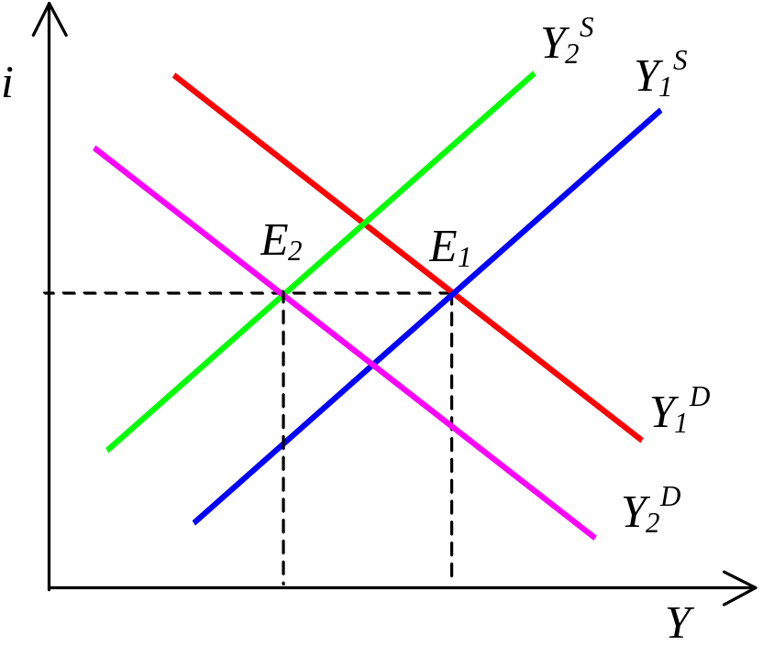
RBC Theory- The Overall Market II
1) permanent parallel shift to production function down- bigger income effect- bigger change to Y_{D}, smaller change to Y_{S}. No change to savings and interest rate, no intertemporal substitution
Issue for seminar: What does happen in the RBC model if all change their preferences from leisure to consumption? How is the outcome of the model influenced by unemployment benefits?

Slide 10

RBC Theory- Analytical Version

